Slide 1

Movie Sales Analysis
Power BI
Presented by : Lokesh Gilakathula
Batch 403
Innomatics Research Labs
Dilsukhnagar

Slide 2
Agenda
Introduction
Problem Statement
Objective
Dataset Description
Data Cleaning
Visualization
Dashboard Overview
Conclusion

Slide 3

Introduction
The global movie industry generates millions of dollars in revenue every year, influenced by factors such as genre, ratings, director popularity, and audience engagement.
Understanding how movies perform over time helps businesses plan investments, marketing strategies, and content creation.
This analysis leverages IMDb and box-office data to uncover trends in movie releases, audience preferences, and revenue-driving factors.
By examining production patterns and viewer response, we can help stakeholders make smarter, data-driven decisions.

Slide 4


Problem Statement
The company lacks insights into how movie production and audience preferences have evolved over time.
Decision-makers need clarity on which genres, years, and directors contribute the most to revenue.
There is currently no structured understanding of how ratings and votes influence movie performance.
Without these insights, predicting future trends or investing strategically becomes challenging.

Slide 5

Objective
Clean and prepare the IMDb movie dataset for analysis.
Build interactive dashboards using Power BI.
Analyze trends in movie release counts, revenue, ratings, and votes.
Identify top-performing movies and genres.
To highlight top-performing movies based on votes and popularity, supporting strategic business actions.

Slide 6
Dataset Description:
Dataset Name: IMDb-Movie-Data.csv
Total Records: 1000 Movies
Time period: 2006-2016
Key Columns:
Title
Year
Genre
Director
Actors
Runtime(Minutes)
Rating
Votes
Revenue(Millions)
Metascore

Slide 7


Data Cleaning
Missing values in columns like revenue, metascore, and director names were identified and handled using imputation or removal techniques.
Duplicate records were checked to ensure accuracy and avoid skewed insights.
Data types were standardized (e.g., converting year, votes, revenue into numeric formats).
Genre columns were split and normalized to allow accurate aggregation and visualization.

Slide 8
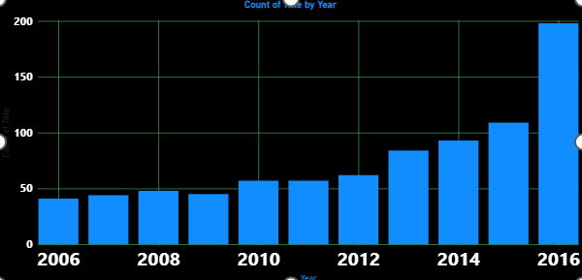
Visualizations:
How many movies were released each year?
Insights:
Movie releases increased steadily over the years, with a major surge in 2016, making it the most productive year by a huge margin.
This indicates a consistent growth trend in film production.

Slide 9
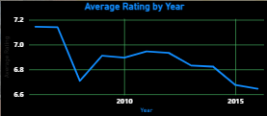
How has the average IMDb rating changed year over year?
Insights:
Average ratings remained fairly stable, mostly between 6.8 and 7.1, showing audience sentiment was relatively consistent.
However, a slight downward trend appears after 2014, indicating more releases but slightly lower average ratings.

Slide 10
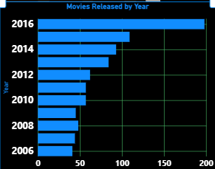
Which are the top five years with the highest number of movie releases?
Insights:
The years 2016, 2015, 2014, 2013, and 2012 saw the highest output, with 2016 leading overwhelmingly.
This reflects a strong expansion phase in the global film industry during this period.

Slide 11
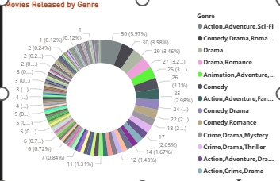
How are movies distributed across different genres?
Insights:
Drama, Action, and Comedy dominate the industry, accounting for the largest share of productions.
Niche genres like Western, War, and Musical are produced far less frequently, highlighting audience demand trends.

Slide 12
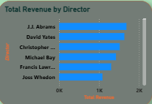
Which directors have generated the highest total revenue across all movies?
Insights:
Directors like J.J. Abrams, David Yates, and Christopher Nolan lead in total revenue, showing their strong box-office consistency.
These directors handle major franchises or large-scale blockbusters that drive high commercial success.

Slide 13
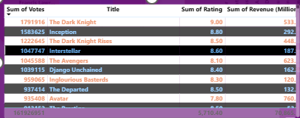
Which movies have received the highest number of votes?
Insights:
Movies such as The Dark Knight, Inception, and The Dark Knight Rises received the most audience engagement through votes.
This indicates exceptional popularity, cultural impact, and long-term audience interest.

Slide 14
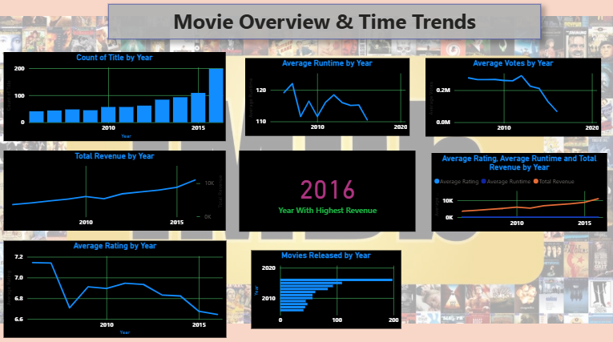
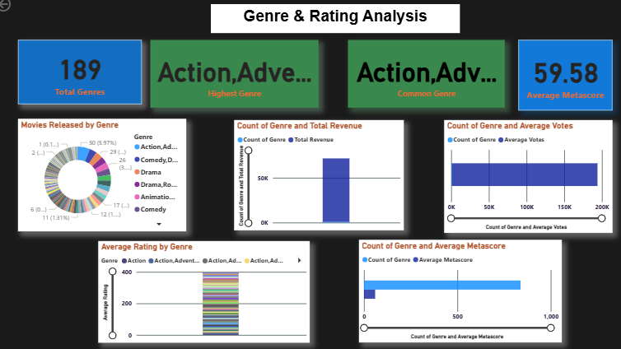
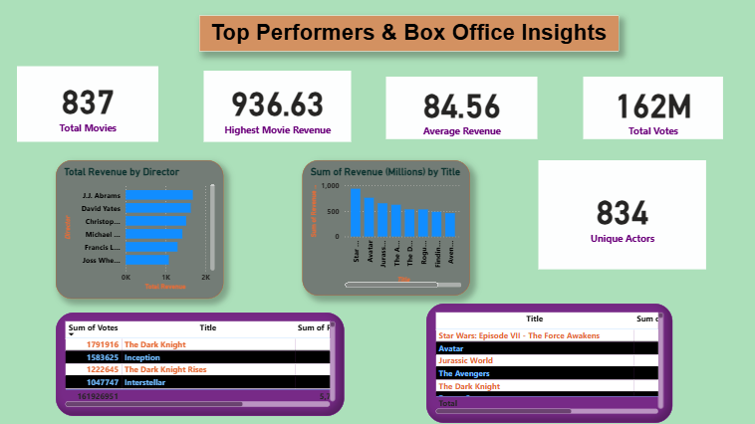
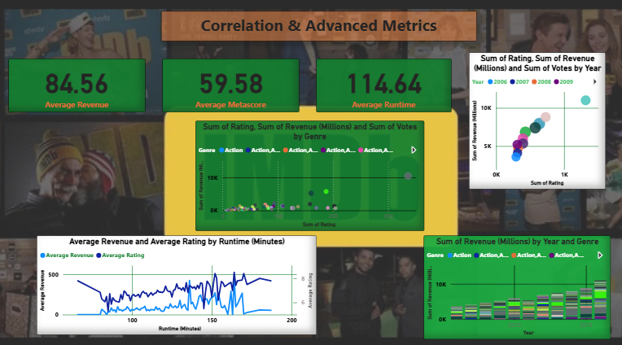
Dashboard Overview:

Slide 15
Conclusion:
Movie production has fluctuated over the years, but specific years stand out as major release peaks, reflecting industry growth cycles.
IMDb ratings show a shifting trend, indicating changes in storytelling quality and audience expectations.
Certain genres consistently dominate production and engagement, offering clear direction for future investments.
Overall, the analysis provides a structured foundation for making informed business decisions in the movie industry.

Slide 16


ANY
Queries
?

Slide 17

THANK YOU

